Slide 1

Business Model Canvas exercise – part one
This work is licensed under the Creative Commons Attribution 2.5 UK: Scotland License.
Notes:
Now that we’ve set the scene for today. We’ll get started on thinking about scoping and refining user requirements.
Without a solid understanding of what users want, it is impossible to develop services that will be used and valued. For the next 20 minutes, we’ll share some tips on how to start assessing user requirements at your institution. We’ve distilled key points from our How to Develop RDM
Services and How to Discover Requirements for Research Data Management Services guides – both are included in your packs so that you can delve into these in more detail once you return home.

Slide 2
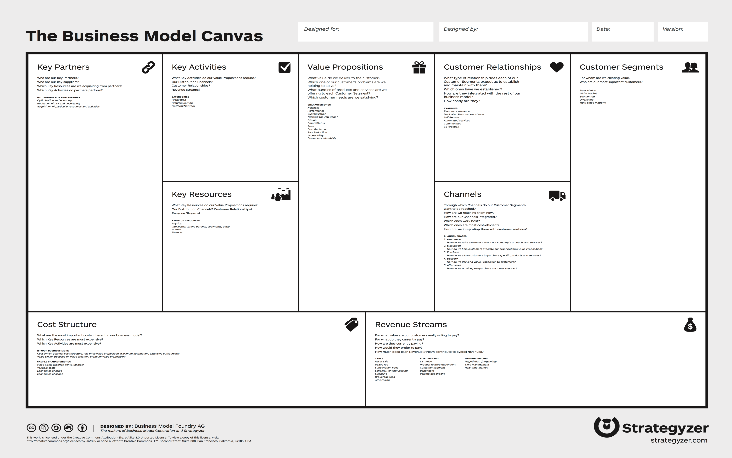
Business model canvas
Notes:
We will be working through the business model canvas to develop a business case for establishing RDM support components. It’s worth bearing in mind as you work through this tool what it is that you are aiming to achieve. It will be helpful to have a level of capability in mind as this will define what is an appropriate level of resource and will help to identify the benefits that the expenditure of resources will unlock.

Slide 3
Group exercise – value
From your individual perspectives:
Identify the customers who will interact with your service area.
Consider the reasons that your customers will use your service over possible alternatives. This may include not using a service at all. These represent the value proposition(s) for your RDM service.
Are there multiple stakeholders?
Will they each derive different value from the service?

